Slide 1

Knessight
Group 107
Oryan Hassidim | Betzalel Yanir | Avi Sommer
Mr. Effi Levi | Prof. Shaul Shenhav

Slide 2

Problem
Raw Knesset data vs. user-relevant information
Isolated statements vs. Discourse trends
Available data vs. unavailable insights

Slide 10
Solution
Big political database
Score
UI
Filter

Slide 11
Solution
Big political database
Data (and sentiment) analysis using AI
Useful, simple, user-friendly UI for analysis display
Existing Work:
IsraParlTweet – Raw Database – the Israeli parliamentary and Twitter resource
Guy Mor-Lan, Effi Levi, Tamir Sheffer, Shaul R. Shenhav ~ HUJI
Knesset-DictaBERT – a Hebrew language model for parliamentary proceedings
Gili Goldin, Shuly Wintner ~ University of Haifa
Political – similar idea, but on much smaller scale – a startup for making political information more accessible
Itai Leshem

Slide 12
Technical Challenges
we encountered 2 main challenges so far:
The Filtering problem
First attitude-low level- key words, small models- high sparsity
LLMs- difficult generalizm
The analysis problem
Difficult political nueances
Small LLM’s – high mistakes rate
Clarity-Accuracy Balance(lesser significant)
Over-all Score? Median? Average? All sentences?

Slide 13
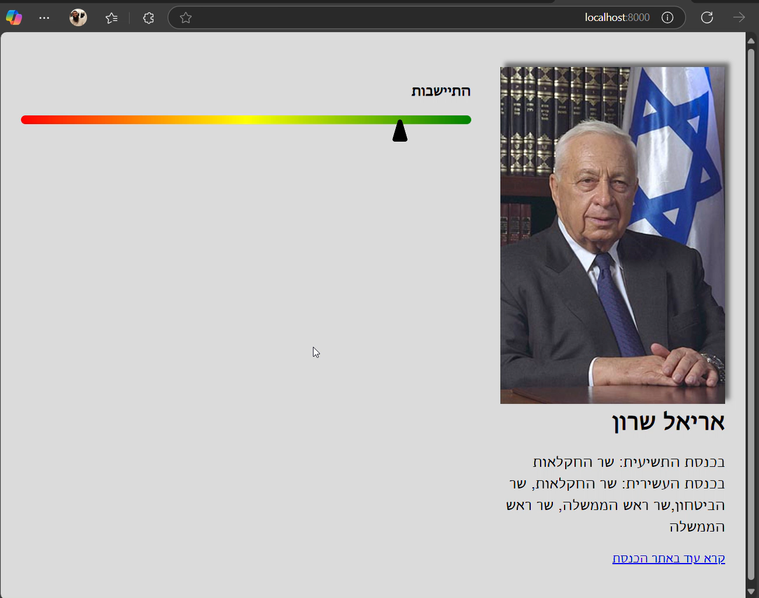
Demo

Slide 14
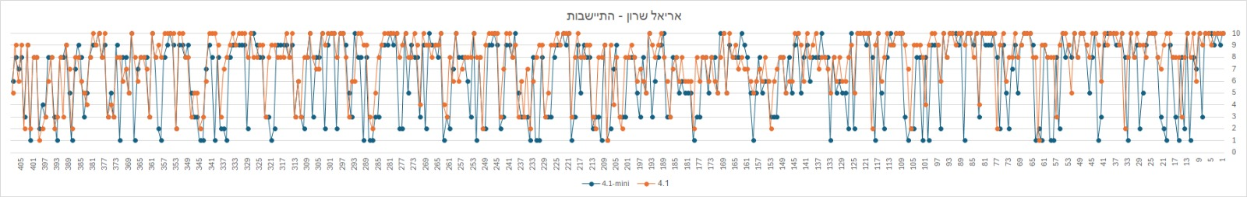
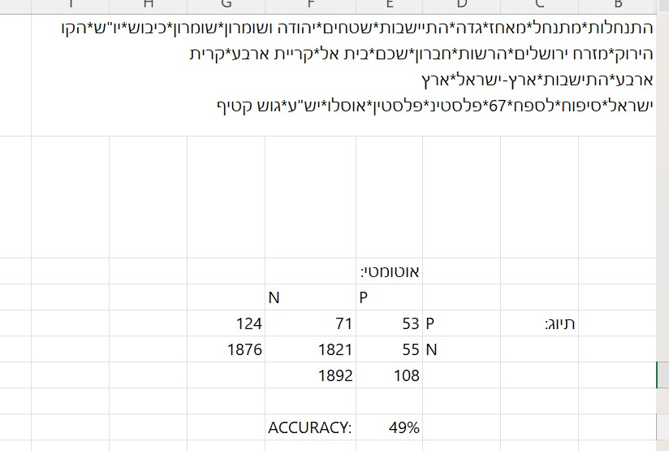
Failures

Slide 15
Failures

Slide 16
Failures

Slide 17
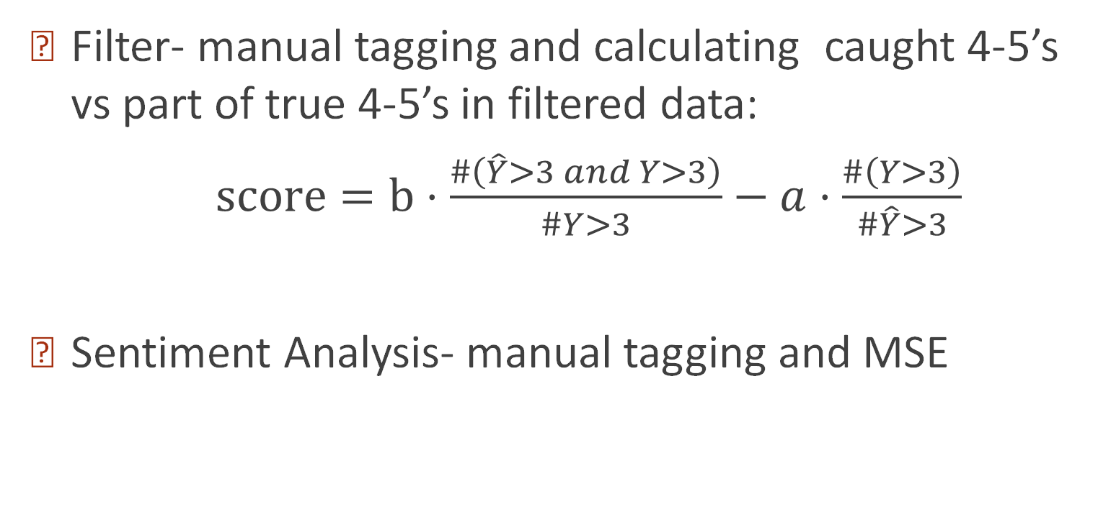
Evaluation Methods
Filter- manual tagging and calculating caught 4-5’s vs part of true 4-5’s in filtered data:
$\text{score}=b⋅\frac{\#\left(\hat{Y}>3 and Y>3\right)}{\#Y>3}−a⋅\frac{\#\left(Y>3\right)}{\#\hat{Y}>3}$
Sentiment Analysis- manual tagging and MSE

Slide 18
Future Milestones
Full analysis for multiple MK’s
Boosting methods(LLM’s) and BERT
Adding more useful info, like consistency

